Slide 1
Pointers, Polymorphism, and
Memory Allocation
C++ Interlude 2
© 2017 Pearson Education, Hoboken, NJ. All rights reserved

Slide 2
Memory Allocation for Variables and Early Binding of Methods
Declare variable x to have data type int
  C++ compiler allocates memory cell to hold an integer
  Use the identifier x to refer to this cell
A function’s locally declared variables
  Placed into an activation record with parameters and bookkeeping data
  Activation record placed on run-time stack
  Activation record destroyed when function finished
© 2017 Pearson Education, Hoboken, NJ. All rights reserved

Slide 3
Memory Allocation for Variables and Early Binding of Methods
Storage for data members of an object
  Also placed into an activation record.
  Data fields placed on the run-time stack just as primitive data types are.
This is early binding , made during compilation
  Cannot be altered during execution
© 2017 Pearson Education, Hoboken, NJ. All rights reserved

Slide 4
Memory Allocation for Variables and Early Binding of Methods
Automatic memory management and early binding sometimes insufficient
  Need to take advantage of polymorphism.
  Must access an object outside of the function or method that creates it.
© 2017 Pearson Education, Hoboken, NJ. All rights reserved

Slide 5
Problem to Solve
Need to write a function – takes two arguments:
  An object of any of the three types of boxes (from Interlude 1)
  An item of type string
Function should place item in box by invoking box’s setItem method
© 2017 Pearson Education, Hoboken, NJ. All rights reserved

Slide 6
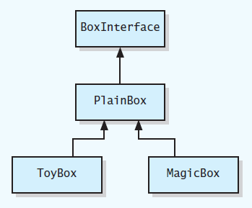
Problem to Solve
FIGURE C2-1 UML class diagram for a family of classes
© 2017 Pearson Education, Hoboken, NJ. All rights reserved

Slide 7
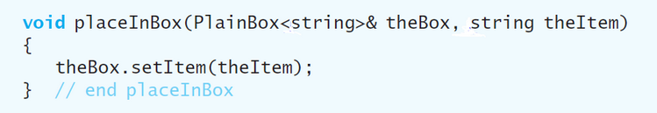
Problem to Solve
You may think this function would suffice
© 2017 Pearson Education, Hoboken, NJ. All rights reserved

Slide 8
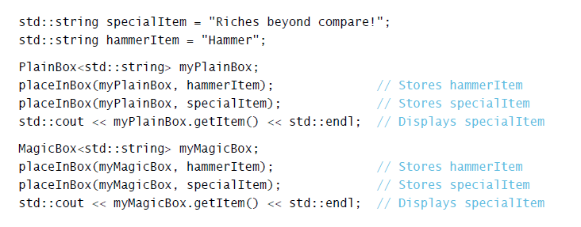
Problem to Solve
Used in this context
Code compiles, but does not perform as you would expect due to
© 2017 Pearson Education, Hoboken, NJ. All rights reserved

Slide 9
Problem to Solve
Version of setItem called is determined when the program is compiled.
Need a way to communicate to compiler
  Code to execute should not be determined until program is running.
  Called late binding
© 2017 Pearson Education, Hoboken, NJ. All rights reserved

Slide 10
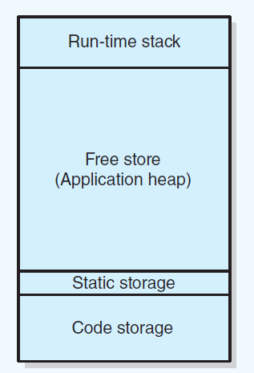
Pointers and Program’s Free Store
FIGURE C2-2 Sample program memory layout
© 2017 Pearson Education, Hoboken, NJ. All rights reserved

Slide 11
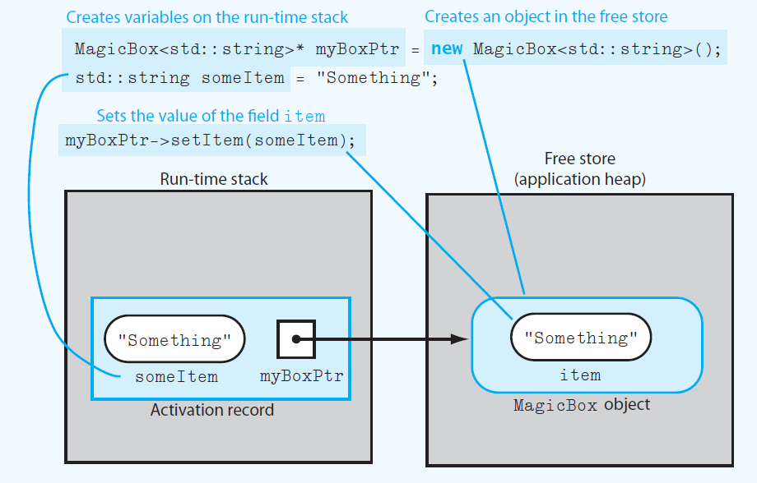
Pointers and Program’s Free Store
FIGURE C2-3 Run-time stack and free store after myboxPtr points to a MagicBox object and its data member item is set
© 2017 Pearson Education, Hoboken, NJ. All rights reserved

Slide 12
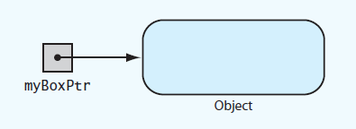
Pointers and Program’s Free Store
FIGURE C2-4 myBoxPtr and the object to which it points
© 2017 Pearson Education, Hoboken, NJ. All rights reserved

Slide 13
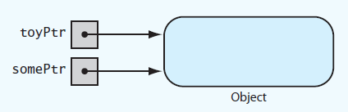
Pointers and Program’s Free Store
FIGURE C2-5 Two pointer variables that point to the same object
© 2017 Pearson Education, Hoboken, NJ. All rights reserved

Slide 14
Deallocating Memory
When memory to which pointer variable points is no longer needed
  Deallocate it by using delete operator.
Then set pointer variable to nullptr
Otherwise dangling pointer exists
  It would still contain address of object that was deallocated.
  Can be source of serious errors.
© 2017 Pearson Education, Hoboken, NJ. All rights reserved

Slide 15
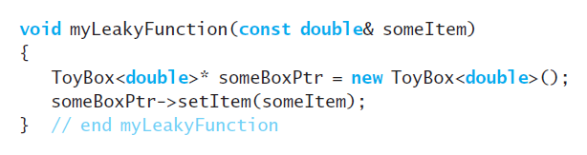
Avoiding Memory Leaks
Memory leaks occur when
  An object has been created in the free store, but
  Program no longer has a way to access
LISTING C2-1 Poorly written function
that allocates memory in the free store
© 2017 Pearson Education, Hoboken, NJ. All rights reserved
Notes:
This is probably a test question; point out where the memory leak is…

Slide 16
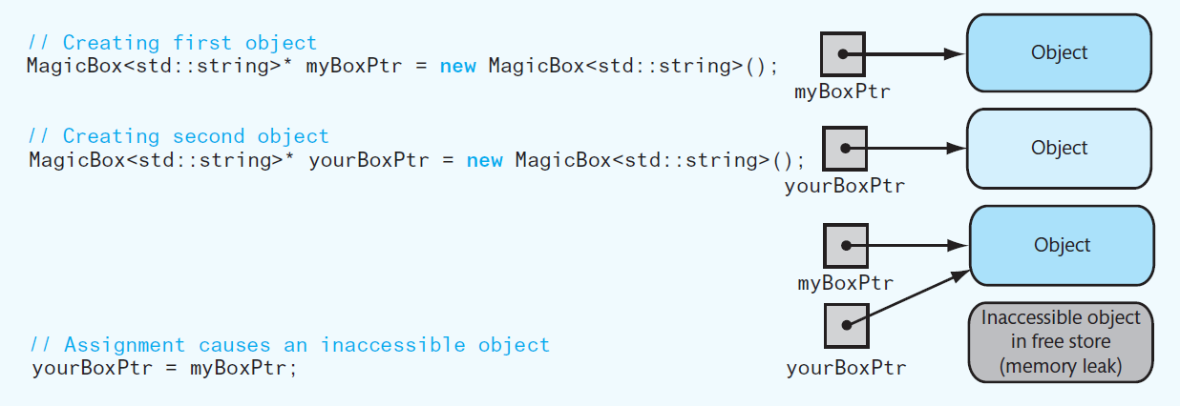
Avoiding Memory Leaks
Figure C2-6 An assignment that causes an inaccessible object.
To prevent memory leak, do not use a function to return a pointer to a newly created object
© 2017 Pearson Education, Hoboken, NJ. All rights reserved

Slide 17
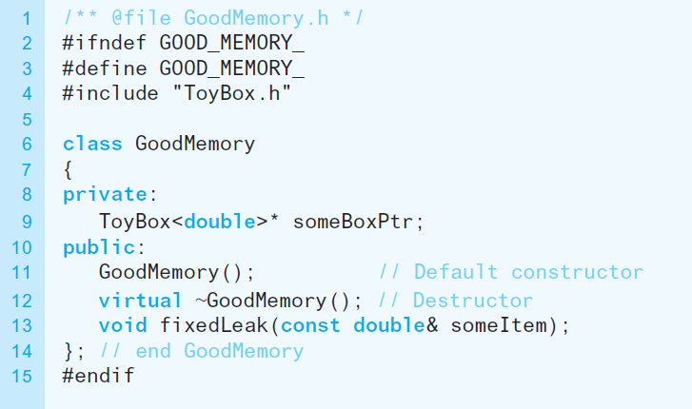
Avoiding Memory Leaks
LISTING C2-2 Header file for the class GoodMemory
© 2017 Pearson Education, Hoboken, NJ. All rights reserved
Notes:
Good practice to mark destructors and put the virtual keyboard
Without a destructor, you can delete the pointer but memory will still be allocated to it but there will be no way to access

Slide 18
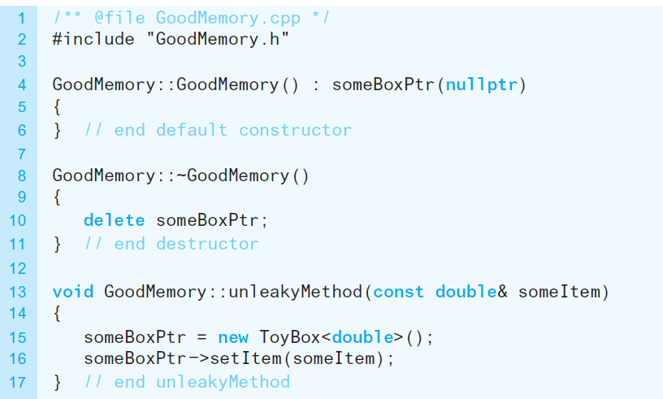
Avoiding Memory Leaks
LISTING C2-3 Implementation file for the class GoodMemory
© 2017 Pearson Education, Hoboken, NJ. All rights reserved
Notes:
Without setting up a default constructor, a random pointer number address will be assigned.

Slide 19
Avoiding Dangling Pointers
Situations that can cause dangling pointer
  if you do not set a pointer variable to nullptr after using delete
  If you declare a pointer variable but do not assign it a value
© 2017 Pearson Education, Hoboken, NJ. All rights reserved
Notes:
2nd one happens by default

Slide 20
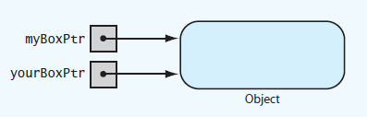
Avoiding Dangling Pointers
FIGURE C2-7 Two pointers referencing
(pointing to) the same object
© 2017 Pearson Education, Hoboken, NJ. All rights reserved

Slide 21
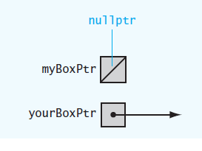
Avoiding Dangling Pointers
FIGURE C2-8 Example of a dangling pointer
© 2017 Pearson Education, Hoboken, NJ. All rights reserved

Slide 22
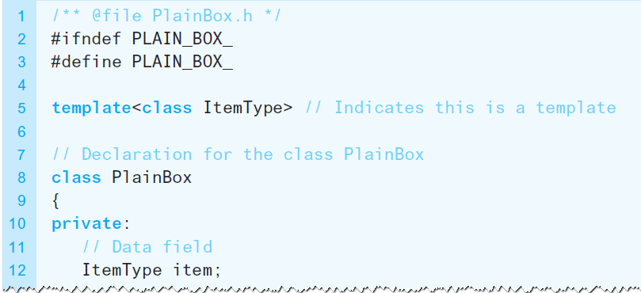
Virtual Methods and Polymorphism
Allow compiler to perform the late binding necessary for polymorphism
  Declare methods in base class as virtual.
LISTING C2-4 Revised header file for the class PlainBox
© 2017 Pearson Education, Hoboken, NJ. All rights reserved
Notes:
Virtual method allows you to call the base class and point to which ever of the sub classes regardless
Example: base class = vehicles with a function GetTire()
Sub classes are cars and trucks
With virtual method enabled, GetTire() will work regardless of if it needs to work on a car or a truck

Slide 23
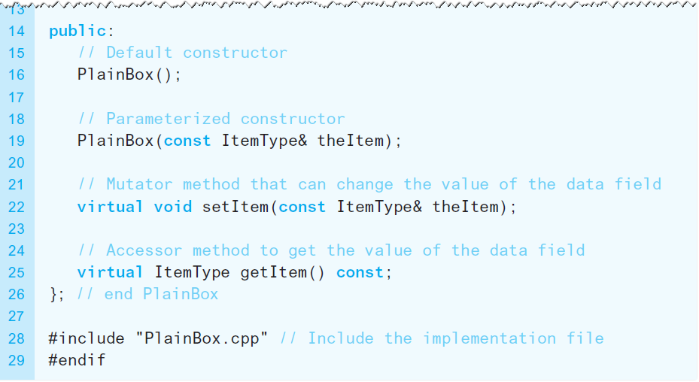
Virtual Methods and Polymorphism
LISTING C2-4 Revised header file for the class PlainBox
© 2017 Pearson Education, Hoboken, NJ. All rights reserved

Slide 24
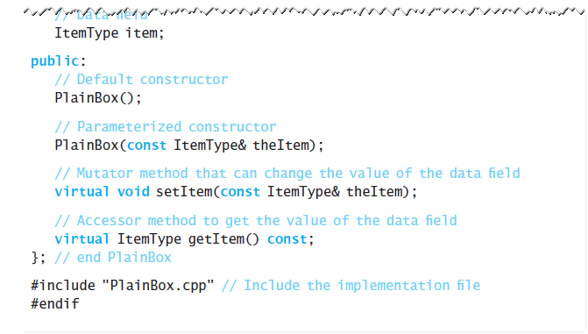
Virtual Methods and Polymorphism
LISTING C2-4 Revised header file for the class PlainBox
© 2017 Pearson Education, Hoboken, NJ. All rights reserved

Slide 25
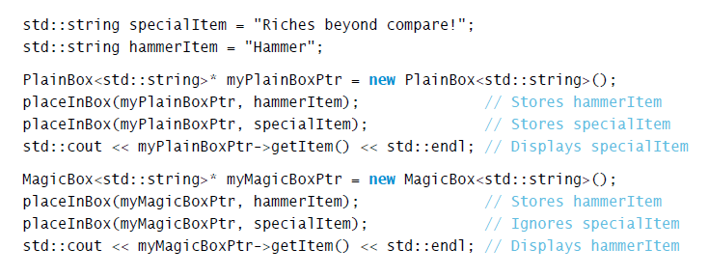
Virtual Methods and Polymorphism
To fully implement late binding, create variables in
free store and use pointers to reference them
© 2017 Pearson Education, Hoboken, NJ. All rights reserved

Slide 26

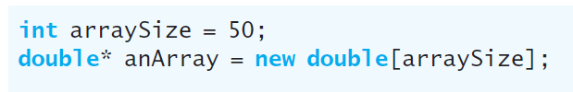
Dynamic Allocation of Arrays
An ordinary C++ array is statically allocated
Can use new operator to allocate an array dynamically
© 2017 Pearson Education, Hoboken, NJ. All rights reserved
Notes:
If you call new, you have to call delete at some point – test question

Slide 27

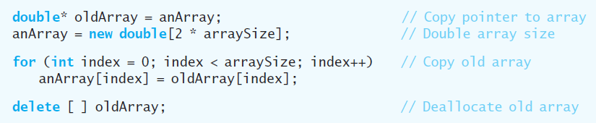
Dynamic Allocation of Arrays
delete returns a dynamically allocated array to system for reuse
Increase size of dynamically allocated array
© 2017 Pearson Education, Hoboken, NJ. All rights reserved

Slide 28
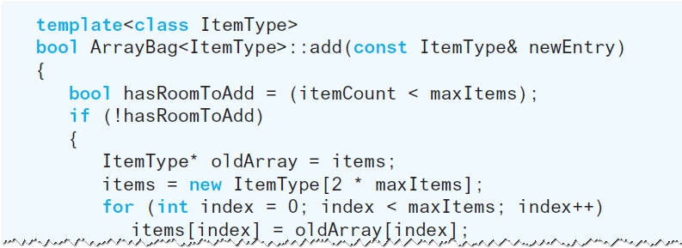
A Resizable Array-Based Bag
Use a resizable array to implement ADT bag so that bag never becomes full
© 2017 Pearson Education, Hoboken, NJ. All rights reserved

Slide 29
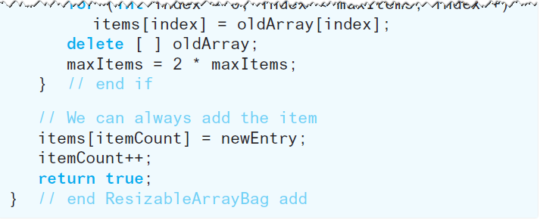
A Resizable Array-Based Bag
Use a resizable array to implement ADT bag so that bag never becomes full
© 2017 Pearson Education, Hoboken, NJ. All rights reserved

Slide 30
End
Interlude 2
© 2017 Pearson Education, Hoboken, NJ. All rights reserved

